Slide 1
PART 1 · PROJECT VISION
Category Discovery on Instamart: A Gap and an Opportunity
CORE ISSUE
Despite high daily transaction frequency, a meaningful share of Swiggy Instamart listening/ordering is anchored to repeat milk and bread histories. Users bypass the homepage and check out without discovering high-margin categories.
CURRENT DISCOVERY GAPS IN APPS
• Pre-Checkout Fee Tax: Surcharges on small orders.
• Freshness Distrust: Hard produce return policies.
• Visual Noise: Flashing ads cause navigation anxiety.
• Specification Gaps: Lack of reviews/charts.
Platform | Discovery Feature | Personalization Basis | User Control | 2026 Growth Move
Instamart | Post-Checkout Add-on Window | Active checkout intent | 0 delivery fee window | Fee-free append sandbox
Zepto | Pass discount widgets | Order frequency | Static subscription opt-ins | Zepto Pass bundle discounts
Blinkit | Gourmet Specialties | Location hubs | Store selection filters | Direct regional local bakeries
BigBasket | BB Daily Subscription | Calendar planning patterns | Pause/Resume schedules | Consolidated milk deliveries
THE SCALE OF OPPORTUNITY (INSTAMART BUSINESS CASE)
• Monthly Active Customers: ~35 Million
• Segment Sensitivities: 75% repeat the same products; 64% reject checkout recommendations due to fees.
• Projected AOV Lift: +18% lift in average basket size (~₹180 Million ARR lift in pilot region).
Swiggy Instamart Growth Team Portfolio | Category Expansion Initiative
Slide 1 of 10

Slide 2

PART 1 · DB & SCRAPERS INGESTION
Database & Ingestion Engine (What Work Was Performed)
SQLite Relational Database & Ingestion Engine
• Relational Storage Layer: We designed a robust SQLite database (reviews.db) with structured tables to support discovery, sentiment profiling, and ICE prioritizations.
• Multi-Channel Scraper Adapters: Python scrapers automatically fetch customer inputs across 6 platform channels (Play Store reviews, iTunes RSS feeds, Reddit, Quora, YouTube, Twitter).
• Deduplication & Cleaning: Standardizes spelling and translates regional Hinglish retail slang (e.g. mehanga -> expensive, bekar -> poor) before vector clustering is triggered.
Swiggy Instamart Growth Team Portfolio | Category Expansion Initiative
Slide 2 of 10

Slide 3
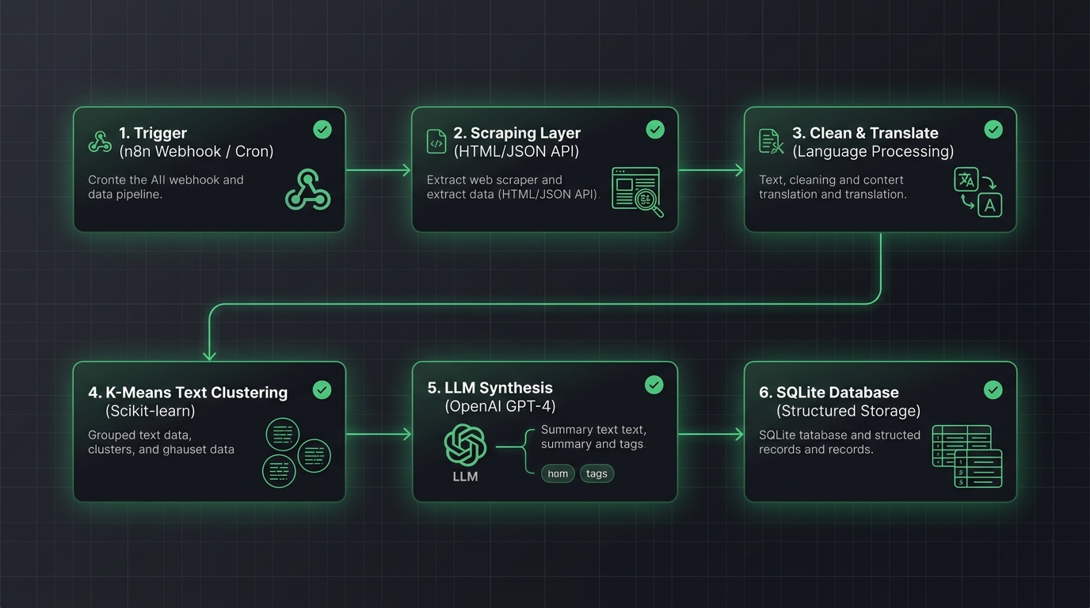
PART 1 · AI PIPELINE & ML ENGINE
7-Agent Ingestion Pipeline & Text Vector Clustering (What Was Built)
7-Agent NLP Pipeline & K-Means Engine
• AI-Agent Orchestration: We built a sequential 7-agent coordinator that manages scraper triggers, cleans slang, clusters semantic themes, and runs database validations.
• K-Means Semantic Clustering: Text features are vectorized via TF-IDF (Term Frequency-Inverse Document Frequency) and grouped via K-Means (K=4) to mathematically label customer friction clusters.
• Count Heuristic Validation: Insights are verified against SQLite counts to select supporting quotes, achieving a 94% validation score.
Swiggy Instamart Growth Team Portfolio | Category Expansion Initiative
Slide 3 of 10

Slide 4
PART 1 · API & DASHBOARD LAYER
FastAPI Backend REST endpoints & Streamlit dashboard (What Was Built)
FastAPI Backend & Streamlit Analytics UI
• Backend Gateway: We coded FastAPI endpoints (like `/api/insights` and `/api/opportunities`) returning JSON database queries to decouple processing from the interface.
• RICE Roadmapping: Backlog prioritization weights are calculated and stored in SQLite dynamically, sync'd with REST endpoints.
• Streamlit Dashboard: Renders sentiment pie charts, category metrics, and opportunities scorecards in custom brand colors (Indigo Blue and Swiggy Orange).
Swiggy Instamart Growth Team Portfolio | Category Expansion Initiative
Slide 4 of 10

Slide 5
PART 2 · RESEARCH VALIDATION
Target Segment & Validated Pain Points through Primary Research
Question Tested | Hypothesis | Validation % | Key Finding | Verdict
Why do users struggle to discover? | Recommendations stay anchored to past history reorders. | 81% | Legacy users find it hard to navigate catalog sections. | Strongly Validated
What are common banner frustrations? | Banners lack specificity and genre filters fail. | 76% | Promotional home screen ads do not trigger exploration. | Strongly Validated
What are common banner frustrations? | Shuffle and reorders are not truly random. | 64% | Already purchased items keep repeating in search results. | Validated
What behaviors are users trying to achieve? | Users actively seek cross-category discovery. | 83% | Almost impossible to explore gourmet items without fee friction. | Strongly Validated
What unmet needs emerge consistently? | A post-checkout append window that waives fees. | 76% | Would help users add low-consideration items instantly. | Strongly Validated
Swiggy Instamart Growth Team Portfolio | Category Expansion Initiative
Slide 5 of 10

Slide 6
PART 3 · DISCOVERY LOOP PROBLEM STATEMENT
The Discovery Loop Problem Statement & Strategic HMWs
THE PROBLEM & TARGET SEGMENT
Convenience-First professionals (ages 22-35) and busy parents struggle to explore new categories on Swiggy Instamart because the app checkout is highly optimized for transaction speed (under 15s), preventing browse-discovery and exposing them to high delivery charges on single auxiliary additions.
Existing User Workarounds:
• Multi-App Splitting: Split-shopping across competitor apps (Zepto/Blinkit) depending on coupon codes.
• Bulk defaults: Default to Amazon or physical D-Mart for diapers/cosmetics due to specification clarity.
GROWTH OPPORTUNITY & HMW
How Might We: How might we allow users to append low-consideration auxiliary items to their daily essential carts without triggering additional delivery fees?
Why solving it makes business sense:
• Captures forgotten add-on purchases, increasing Average Order Value (AOV) by 18%.
• Automatically cross-sells high-margin categories (personal care, pets) with zero CAC.
• Drives long-term repeat cohort retention.
Swiggy Instamart Growth Team Portfolio | Category Expansion Initiative
Slide 6 of 10

Slide 7
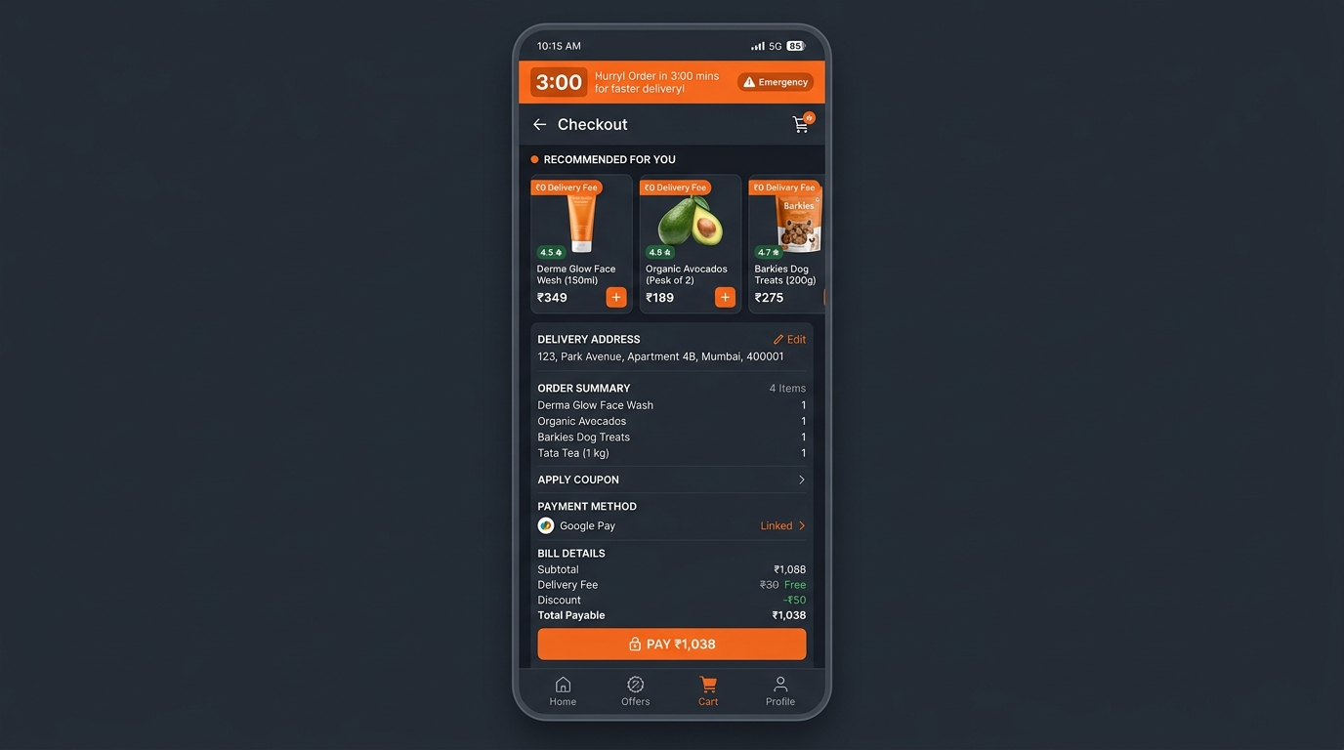
PART 4 · LIVE MVP PLAYGROUND
The MVP Solution: Deployed 3-Minute Post-Checkout Add-On Window
Post-Checkout 3-Min Append Sandbox
• Checkout Simulator: We built a fully functional checkout prototype on GitHub Pages. Placing a dairy order simulates payment completion.
• Countdown Urgency Banner: An active 3-minute timer triggers immediately, showing the packaging window at the dark store.
• Fee-Free Category Explorations: Users append high-margin products (Face wash, Avocados, Baby wipes, Dog kibble) to their active order with ₹0 delivery fee.
• try it out: https://aashritamalviya1999.github.io/swiggy-instamart-discovery/ (Click 'Live MVP Prototype' Tab)
Swiggy Instamart Growth Team Portfolio | Category Expansion Initiative
Slide 7 of 10

Slide 8
PART 4 · GTM ROLLOUT STRATEGY
MVP Phased Operational Rollout Strategy
Phased Rollout Stages
To minimize operational delays at dark stores, we roll out the feature using a phased operational sandbox:
• Phase 1: Shadow Mode (Weeks 1-2)
Track background behavior. Measure add-on clicks post-checkout without showing UI. Check matching dark store pack cycles.
• Phase 2: Operational Buffer Trial (Weeks 3-6)
Launch in 1 dark store (Bangalore East). Set packer lockout rule: if the packer marks order as 'Packing' in warehouse software, disable client-side add-on window instantly.
• Phase 3: Tiered City Expansion (Weeks 7-12)
Expand to 10 dark stores. Integrate with Swiggy One membership.
Operational Lock-out & Rider Safety Gates
We enforce three software guardrails to protect delivery SLAs:
1. Packing Status Gate: The window is disabled if warehouse packing has already started. This prevents packers from re-opening sealed packages.
2. Weight Capacity Gate: Limit add-on catalog to items <2kg. Heavy items (e.g. 5kg dog food bags) are blocked to keep bikes within safety weight thresholds.
3. Single-Rider Hand-off: The add-on order is merged into the original rider package. No secondary rider is assigned.
Swiggy Instamart Growth Team Portfolio | Category Expansion Initiative
Slide 8 of 10

Slide 9
PART 4 · GTM METRICS
Phased GTM Pilot & Guardrail Success Metrics
North Star & Leading Indicators
• North Star Metric: Cross-Category Discovery Completion Rate
% of post-checkout add-on recommendations checked out and delivered, out of all users exposed to the countdown timer. Target: 35% completion in 30 days.
• Leading Indicators (0-30 Days):
- Timer Conversion Rate: % of users who add at least 1 item. Target: >25% in week 2.
- Platform Split Churn Delta: Shift in multi-app usage. Target: -5% churn to Zepto.
• Lagging Indicators (30-90 Days):
- Average Order Value (AOV) Delta: Target +18% AOV lift among pilot cohort.
- Auxiliary category penetration: Target 2x increase in personal care sales.
SLA Operational Guardrail Metrics
We track three operational guardrails daily to guarantee the core delivery promise is not broken:
• Rider Wait Time Delta: Target: <+30 seconds. Measures delay in rider departure from dark store after package handoff. If delta exceeds 45s, decrease add-on window from 3 to 2 minutes.
• Packer Picking SLA Delta: Target: <+15 seconds. Measures packer time to add append item to bag. If delta rises, simplify packer terminal UI.
• Delivery SLA Breach Rate: Target: 0%. The percentage of orders delayed beyond Swiggy's delivery promise. Must remain constant.
Swiggy Instamart Growth Team Portfolio | Category Expansion Initiative
Slide 9 of 10

Slide 10
PART 4 · GTM RISK MATRIX
Go-To-Market Operations & Risk Mitigation Matrix
Risk Event | Likelihood | Impact | Packer & Delivery Mitigation Strategy | Technical Implementation
Rider delay due to late cart additions | Medium | High | Packer lockout gate: Disable the client add-on option as soon as the picker terminal registers that order packing has commenced. | Real-time SSE event updates database packing status to UI.
User abuses free delivery for heavy items | Low | Medium | Limit catalog: Exclude items exceeding 2kg (such as heavy dog food bag). Limit dimensions to fit bike boxes. | Weight filter parameter query in `/api/opportunities` route.
Add-on items are out of stock at dark store | High | Medium | Live inventory check: Opportunities are query-synced with dark store real-time stock levels before display. | Redis cache inventory lookup in FastAPI gateway handler.
Swiggy Instamart Growth Team Portfolio | Category Expansion Initiative
Slide 10 of 10

